Slide 1

J.A.K.E. Weather
Jaewon Heo, Alex Ryse,
Katelyn Wildermuth, Eva Santana

Slide 2
Overview
What is J.A.K.E. Weather?
Development Process
Key Learnings & Reflections
Tech Stack
Tools & Integrations
Additional Features
Live Demo
Questions

Slide 3
What is J.A.K.E. Weather?
A Secure, Full-Stack Weather Platform for Real-Time Forecasting
Key Features: Delivers a real-time 7-day forecast, a dynamic weather map, and secure user authentication for personalized access
Goal: To be the reliable, accurate, and customizable weather source for users across the United States of America
Core Functionality: Gathers and displays real-time weather data across a comprehensive, full-stack web application

Slide 4
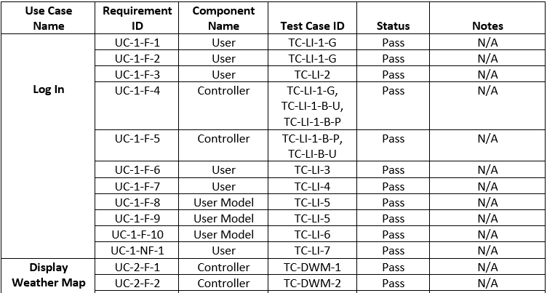
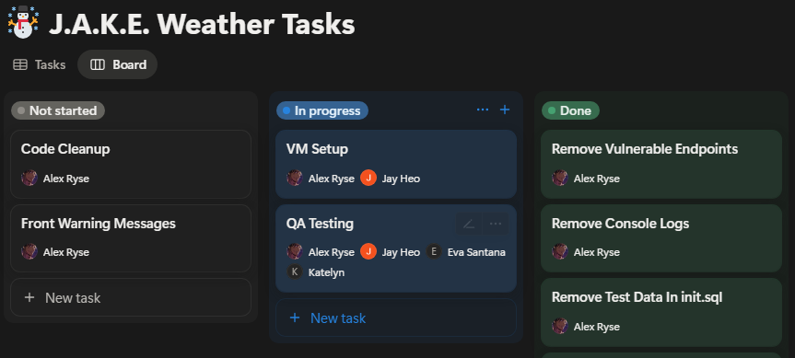
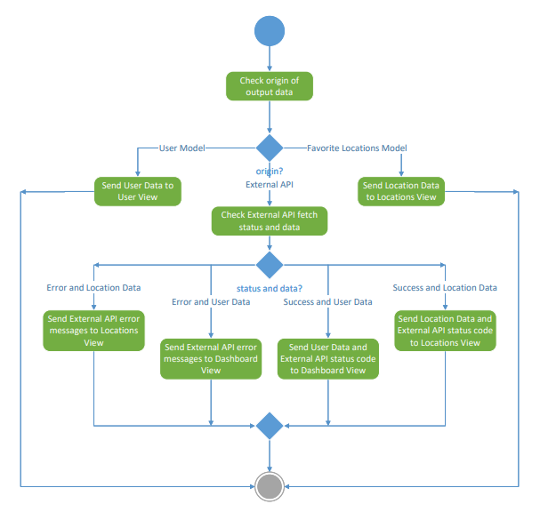


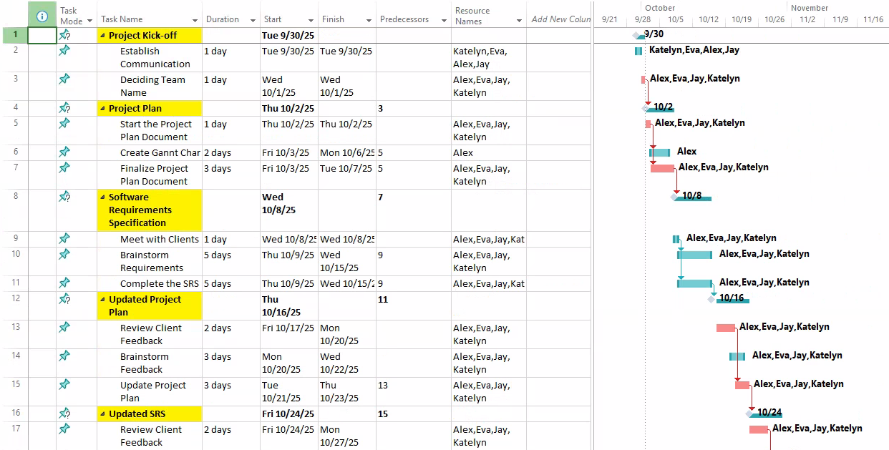
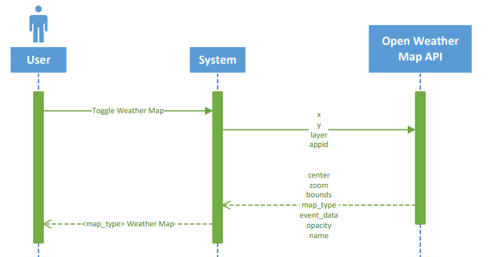
Development Process
Project Plan
1
SRS
2
Design Document
3
Test Plan
4
Implementation
5
Test Report
6

Slide 5
Key Learnings & Reflections
Technical Growth & Problem Solving
Agile approach, asynchronous data fetching, RESTful API and React Component integration
Team Dynamics & Collaboration
Work distribution and accommodation, after class group work, use of Discord
SDLC & Project Management
Scope management, version control - Git and GitHub, client - team communication

Slide 6




Tech Stack

Slide 7







Tools & Integrations

Slide 8
Additional Features
Robust Security: Features password encryption and a password reset process
Personalized Experience: Allows users to manage and customize a list of favorite locations for instant forecasts
Enhanced Map Interactivity: Enables users to search for specific locations on the map, supported by dynamic interaction capabilities (zooming, panning, etc.)

Slide 9

Live Demo

Slide 10

Questions

